Slide 1
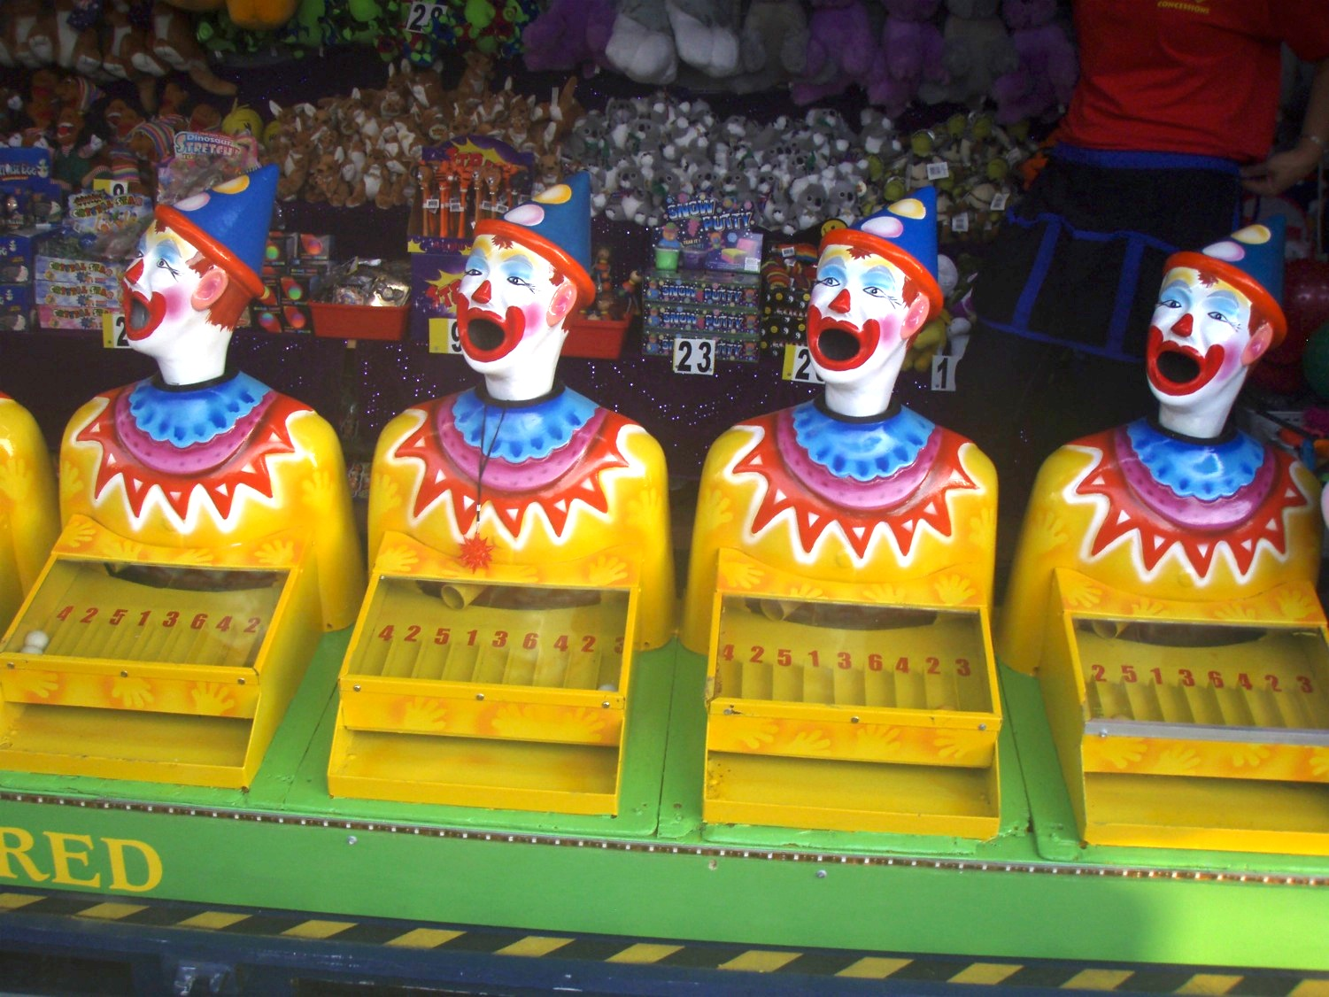
Are we having fun yet?
Institutional resistance and the introduction of play and experimentation into learning innovation through social media
Peter Bryant (LSE), Antony Coombs (Greenwich), Monika Pazio (Greenwich)

Slide 2
The Premise
Learning teaching and assessment can be transformed through…
People not platforms
Action not activity
Producing not consuming
Interacting not broadcasting
Fun not fear
Sharing not distributing
At a local, faculty and institutional level

Slide 3
What is Greenwich Connect?
Timeline
April 2012
Research phase commenced
May 2013
Phase 1 funding approved
Sept 2013
Phase 2 funding approved
May 2014
Phase 3 funding application
Project staffing in place

Slide 4
The Scope
£35000 funding
15 kits of content making devices and platforms
Over 150 devices
15 projects with over 35 staff
The Assumptions
Students and staff already engage with and use technology in personal and sometimes professional capacities. The skills employed vary wildly

Slide 5
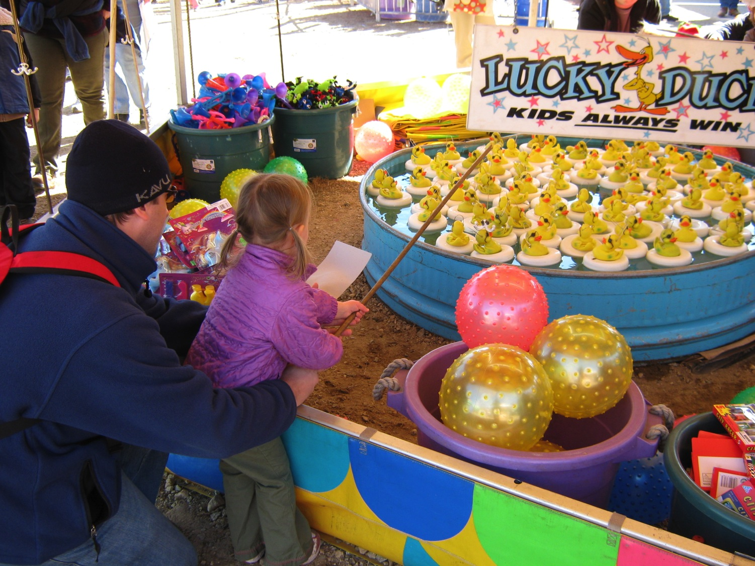
Institutional resistance to technology

Slide 6
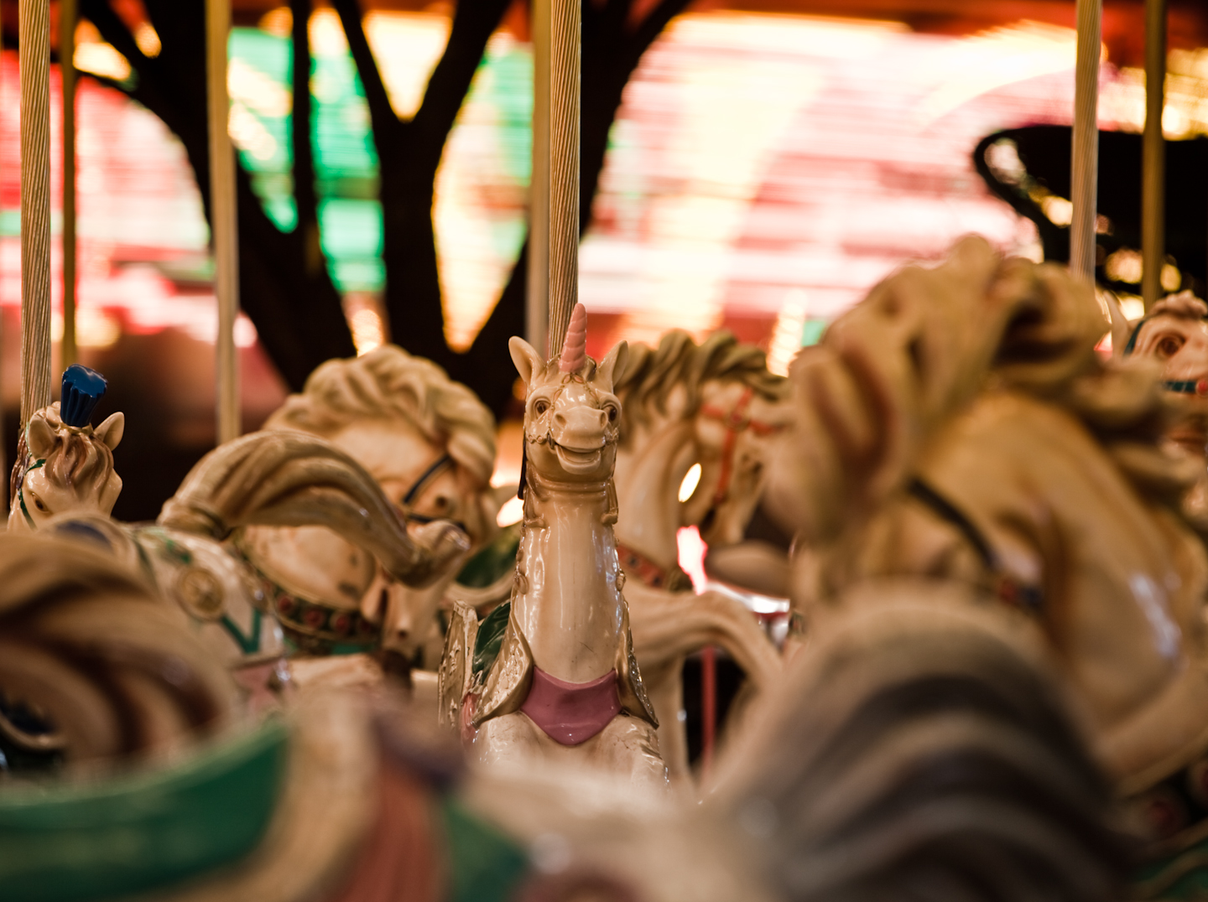
Individual Resistance to Technology

Slide 7
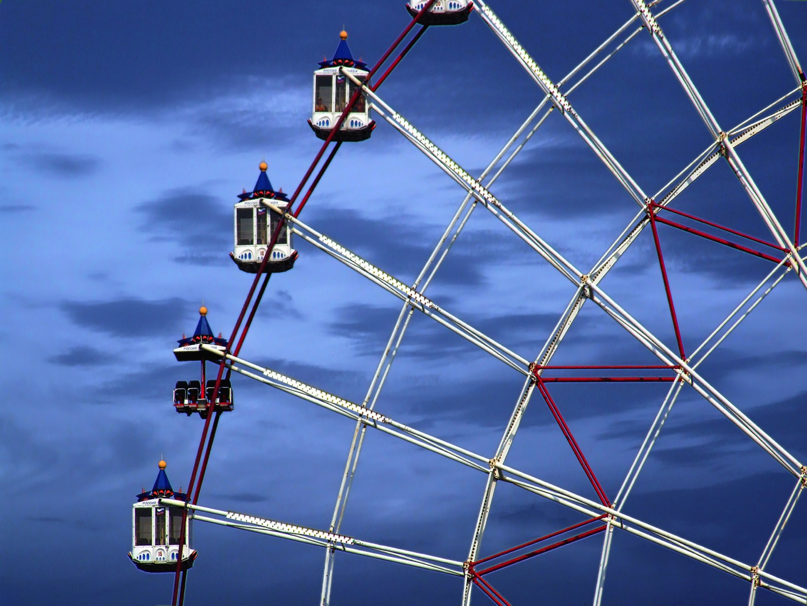
Individual resistance to openness and sharing

Slide 8
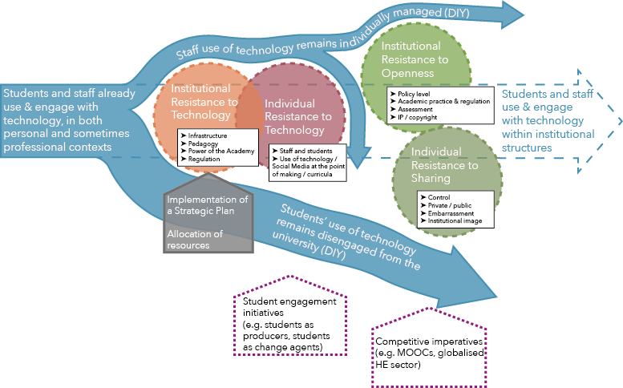
Rivers of resistance

Slide 9
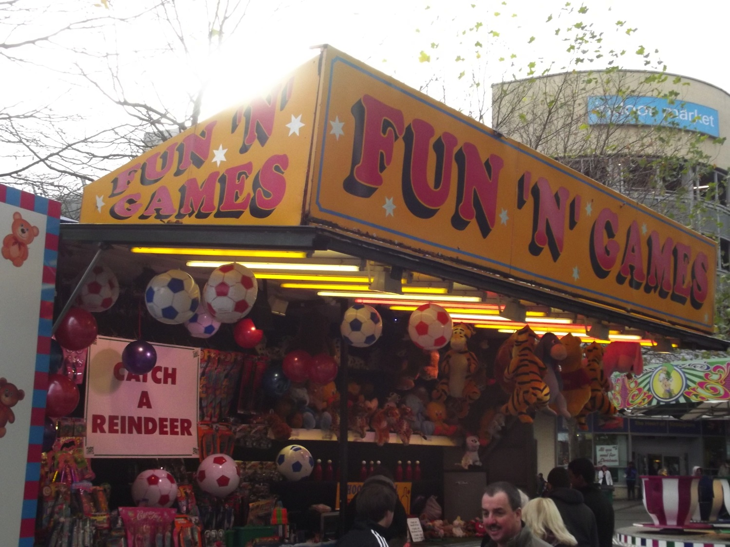
Conclusions

Slide 10
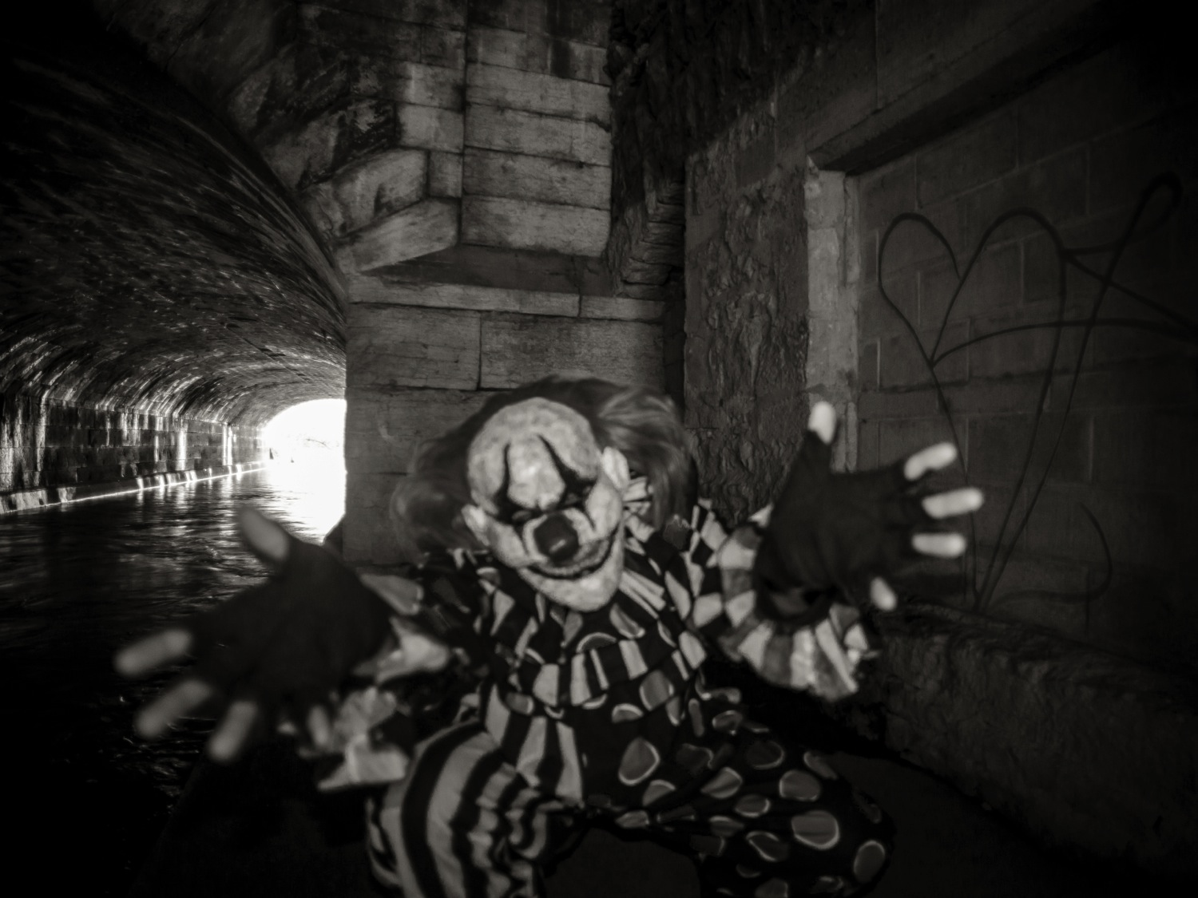
Any questions?

Slide 11
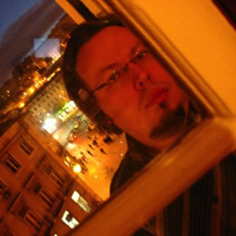
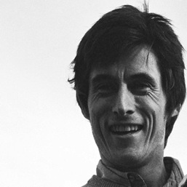
@PeterBryantHE
p.j.bryant@lse.ac.uk
@TELGreenwich
a.coombs@gre.ac.uk
@monikapazio
m.pazio@gre.ac.uk
“Typing the universe” by Feliciano Guimarães
https://www.flickr.com/photos/jsome1/6097841770
Licensed under a Creative Commons Attribution 2.0 Generic Licence
Image by Anthony Easton
https://www.flickr.com/photos/pinkmoose/2775862482
Licensed under a Creative Commons Attribution 2.0 Generic Licence
Image by Abigail Batchelder
https://www.flickr.com/photos/abbybatchelder/4005602119
Licensed under a Creative Commons Attribution Non-Commercial 2.0 Generic Licence
Image by travelkid42
https://www.flickr.com/photos/frozenpeas42/4261819057
Licensed under a Creative Commons Attribution-NonCommercial-NoDerivs 2.0 Generic
Image by Luis Sarabia
https://www.flickr.com/photos/lst1984/1331842348
Licensed under a Creative Commons Attribution Non-Commercial 2.0 Generic Licence
Image by Elliot Brown
https://www.flickr.com/photos/ell-r-brown/11258225826
Licensed under a Creative Commons Attribution Non-Commercial 2.0 Generic Licence
Image by George F
https://www.flickr.com/photos/gfoster67/8697824640
Licensed under a Creative Commons Attribution-NonCommercial-NoDerivs 2.0 Generic

